Slide 1
Food First
Personal Restaurant Recommendation application
Instructor: Sambit Sahu
Zihui Yuan(zy1028), Guangwei Zhang(gz667), Weijun Zhai(wz1131）
New York University
https://youtu.be/9ku7WCvCoDg

Slide 2
Introduction
Created a personal restaurant recommendation web application
Adopted AWS services: S3, Lambda, Cognito, API gateway, ElasticSearch,AWS Machine Learning, DynamoDB, Kinesis, SQS, SNS
Used a serverless architecture
Front-End: web pages hosted on S3
Back-End:
Used Cognito to provide user authentication service
Used Lambda function to provide logic services
Used Elasticsearch, AWS ML, Kinesis to provide restaurant recommendation
Used Dynamodb to store restaurant data and user preference data
Used SNS to provide text information sending service
Collected restaurant data from Yelp API
Built machine learning classification model by using AWS Machine Learning Module
Used Kinesis to record user log data

Slide 3
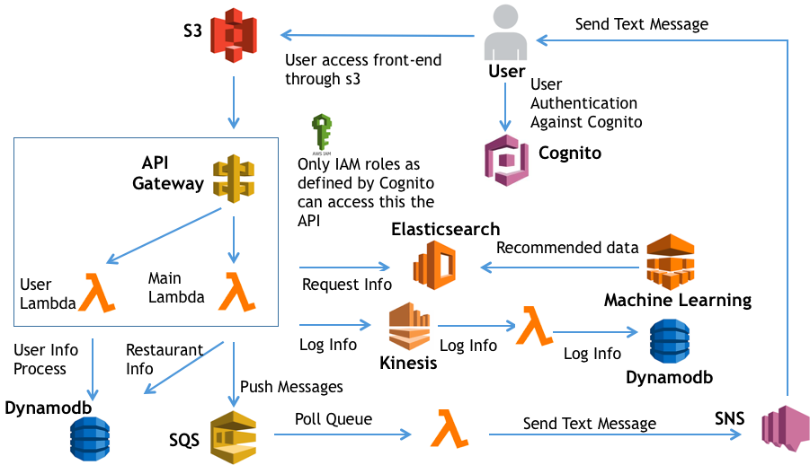
Application Architecture

Slide 4
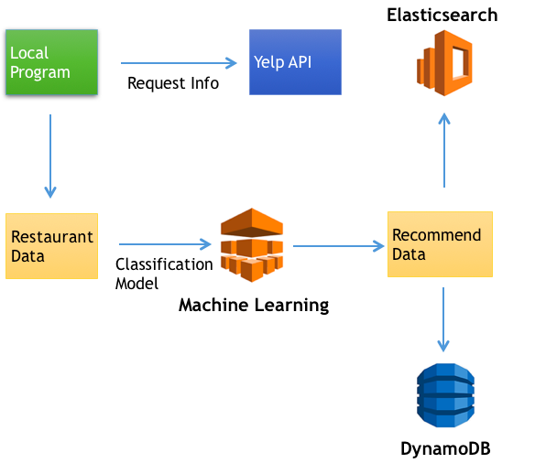
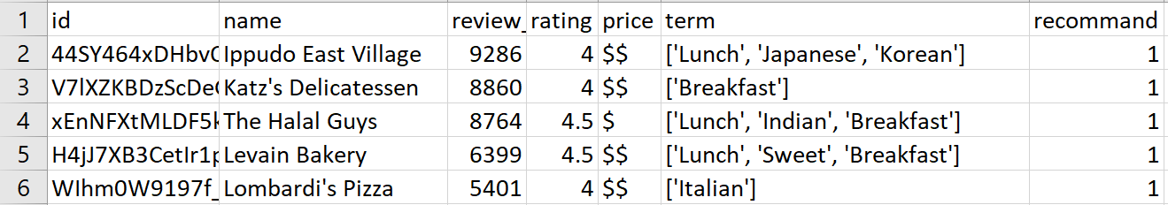
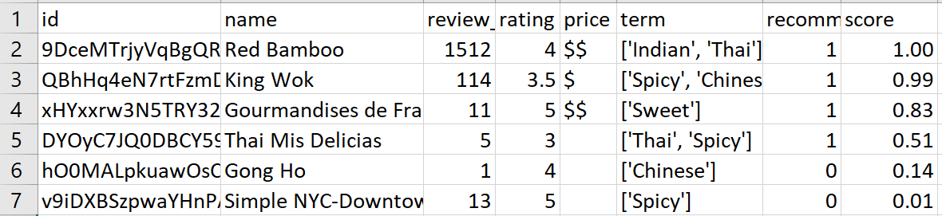
Data Processing
Notes:
Scraped some data from Yelp to build the data set
Process the data and make training data like this.
Then we send data for machine learning to get our recommend data.
Then these data were split into two parts, key attributes for Elasticsearch and detailed information for DynamoDB

Slide 5
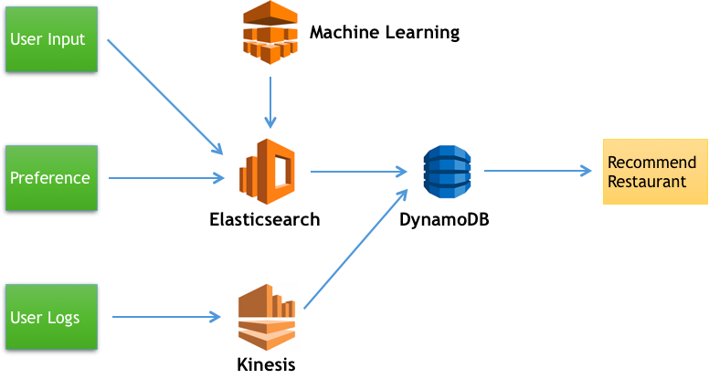
Recommendation Schema
Notes:
When user wants to search something, by input and/or their preference, we refer to Elasticsearch to get recommended restaurant ids and get detailed information from DynamoDB and display to user.
We also collect user logs to Kinesis data stream and analyze most frequently occurring items. User can also search for this information.

Slide 6
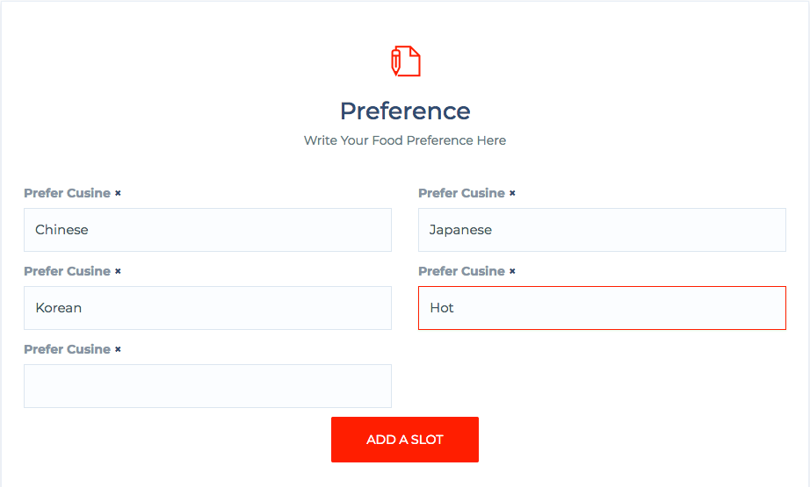
User Preference Interface
A User Preference list is maintained on DynamoDB
"unstructured": {
"username": "Test",
"fullname": "Test",
"email": "wz1131@nyu.edu",
"phone": "6465156***",
"address": "627 40th st",
"zip": "00000",
"prefer": [
"Chinese",
"Japanese",
"Korean",
"Hot"
]
}

Slide 7
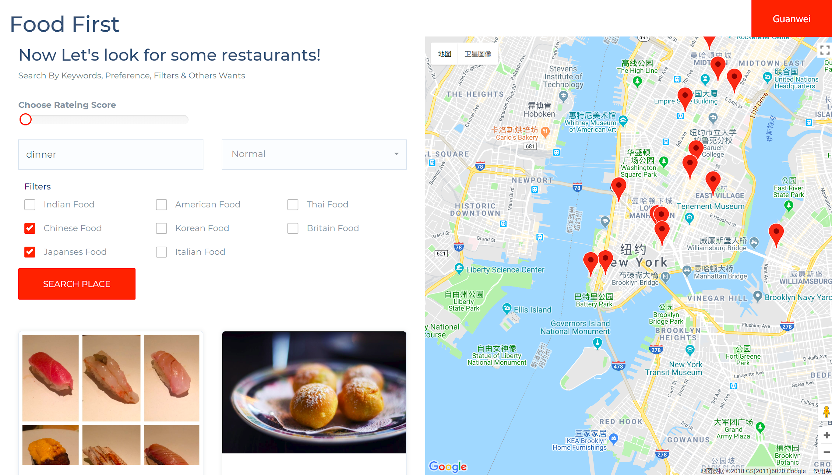
Application Interface

Slide 8
Thanks

